Slide 1
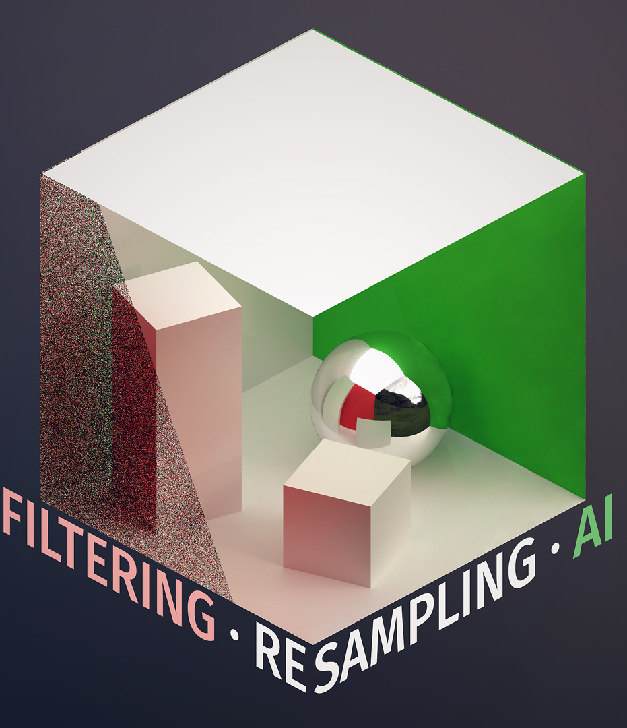
REAL TIME DENOISING WITH DL: Milestone 2
Ryan Tong, Tom Donnelly, Shixuan Fang
Advised by Liam Dugan

Slide 2
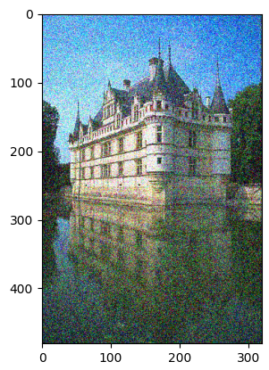
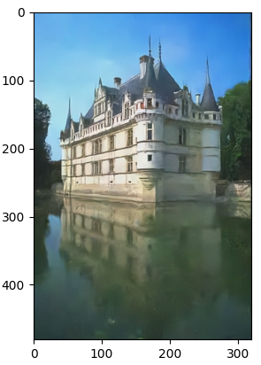
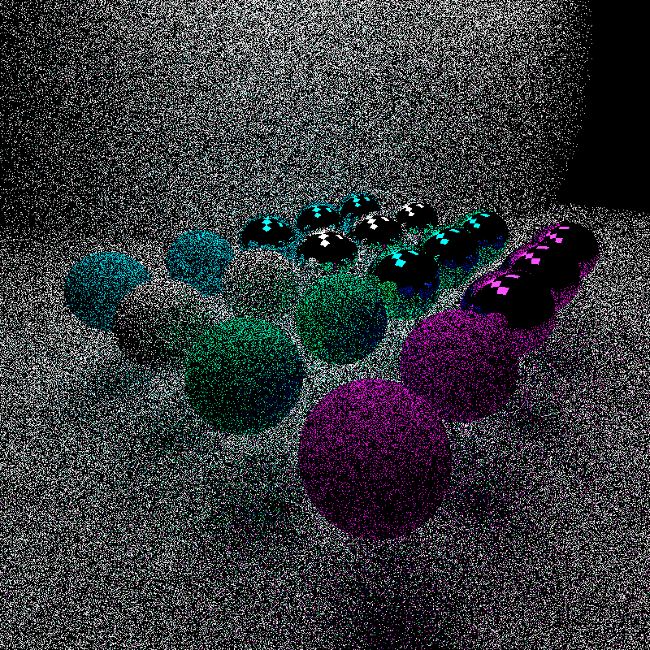
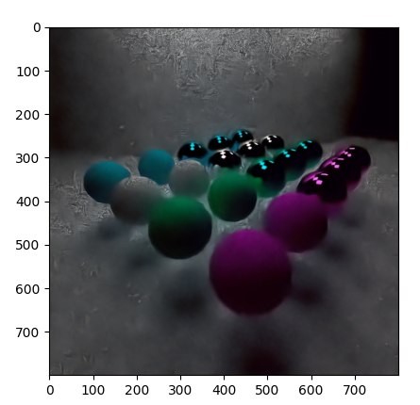

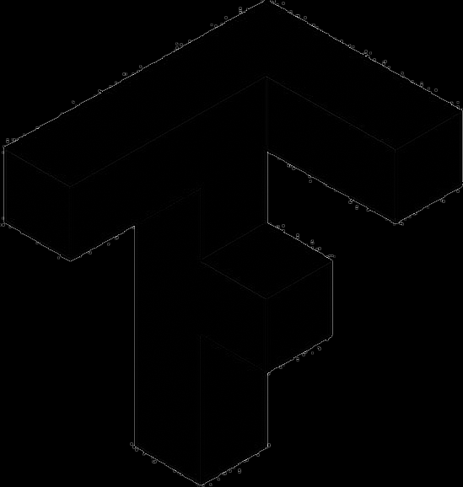
Previous Milestone
cuDNN and openCV setup
Found and discovered dnCNN and FFDNet models
Weight loading script
cuDNN toy example
Paper reading

Slide 3
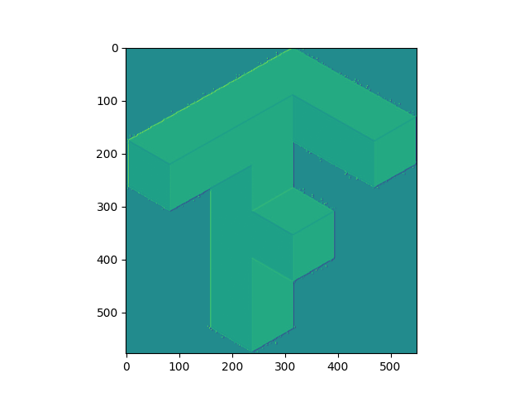
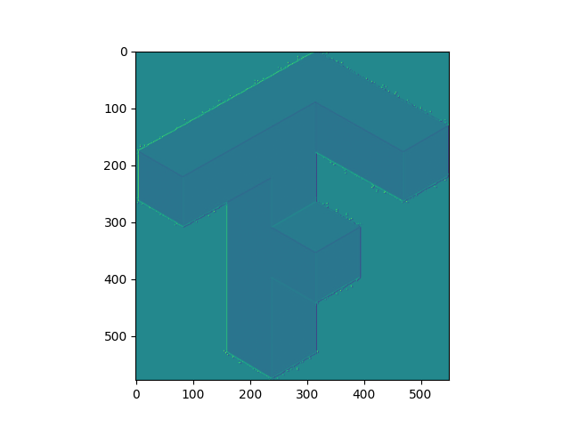
Progress
cuDNN code to run images through entire dnCNN net given a set of weights
Pipeline is complete but debugging is still in progress
Lots of helper code to make integrating into the path tracer easier
Images are visualization after a single convolutional pass
Pytorch Output
pytorch .pth file
weights & bias .csv files
cuDNN tensor
.png or .txt after convolution
Visualization of cuDNN output

Slide 4
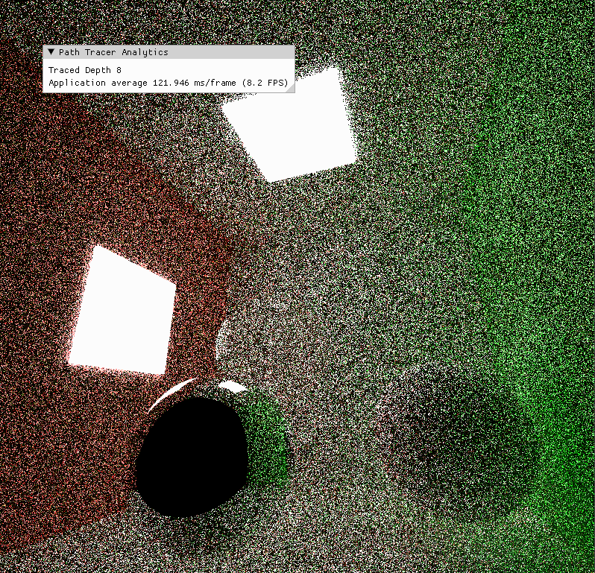
Progress
Data generation pipeline:
Takes in a scene or scenes
Generates camera angles to cover the scene
Saves SPP 1 - 16 iterations and ground truth image
Save GBuffer for possible use
Scene Generator:
Takes in a number and generates that many of different scene files
Each scene contains random number of materials and objects
Only cornell box scenes for now, will change later if needed Current Data: 185 Samples of Cornell box, 200 Different Cornell Scenes

Slide 5
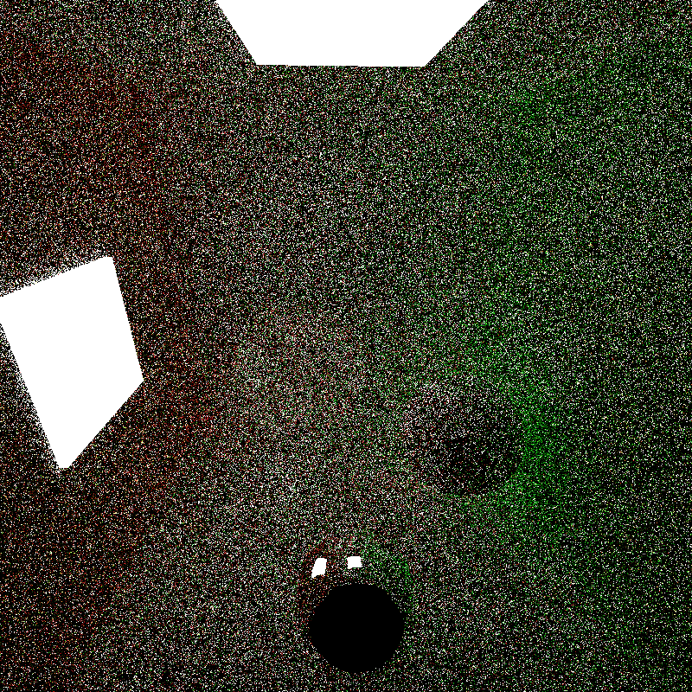
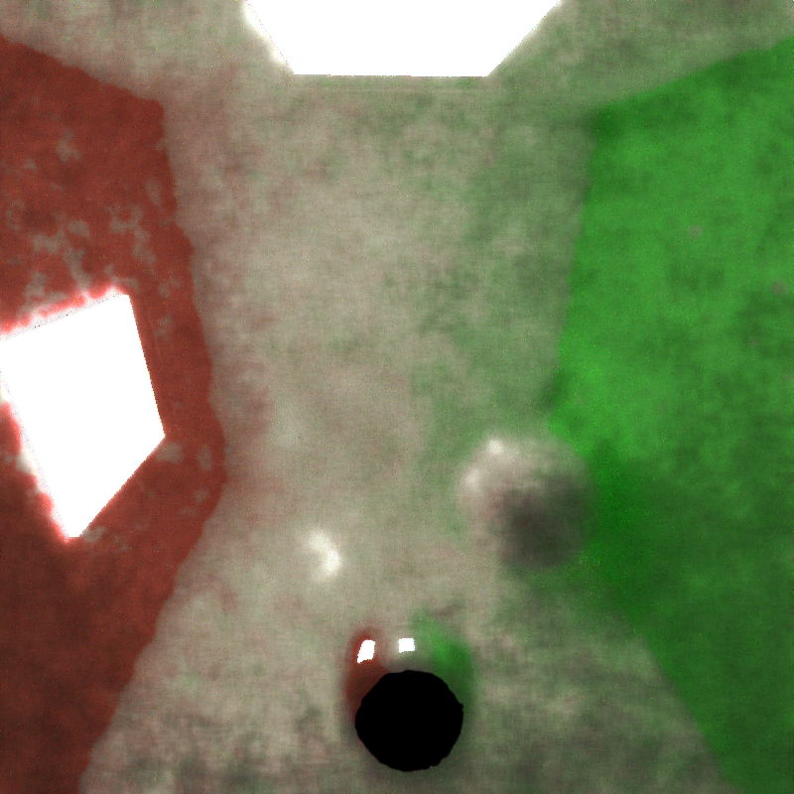
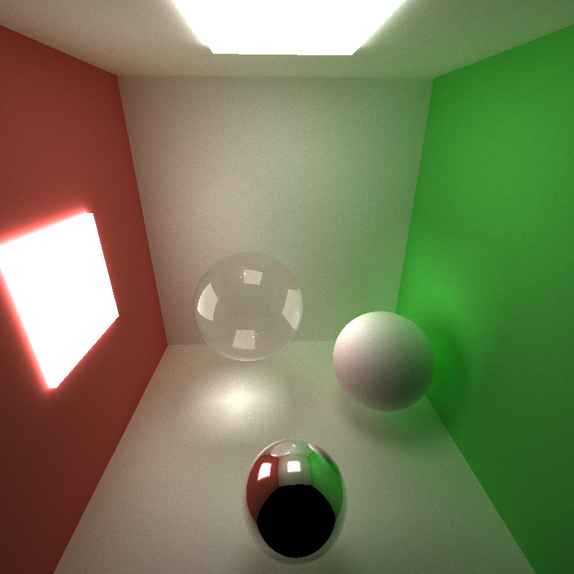
Progress
1 SPP Sample
DnCNN Prediction, 1 SPP Training,
6000 Iterations
5000 SPP Ground Truth

Slide 6
Next Steps
Continue gathering of training data
Not just cornell scenes
Use multiple machines to get even more data
Adapt the authors training pipeline to be more suitable to our task
Train multiple models for different scenes
Put cuDNN code into path tracer (even if models aren’t ready yet)
Start generating performance metrics
How long does our path tracer take to do n iterations
How long does the denoising model take to run on a single frame
Investigate using gbuffer in model
Start looking at resolution up-scaling models

